Slide 1
Software Engineering
Lecture #45
Fakhar Lodhi

Slide 2
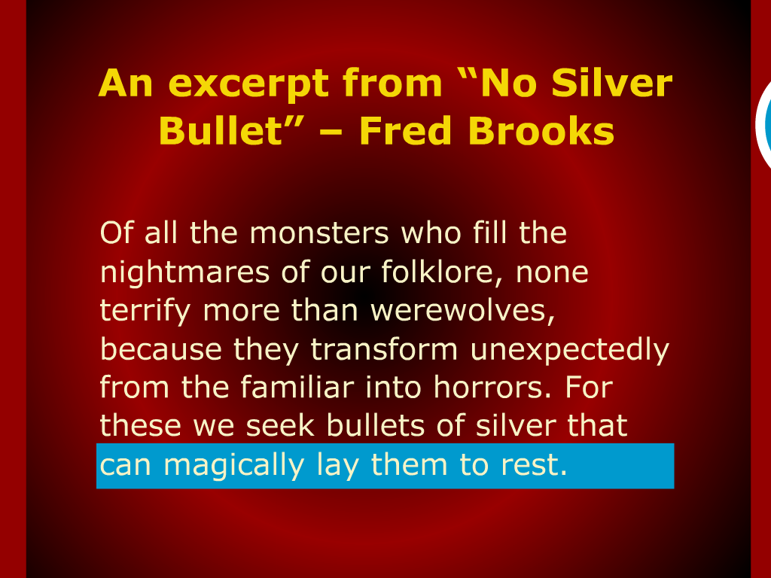

Slide 3
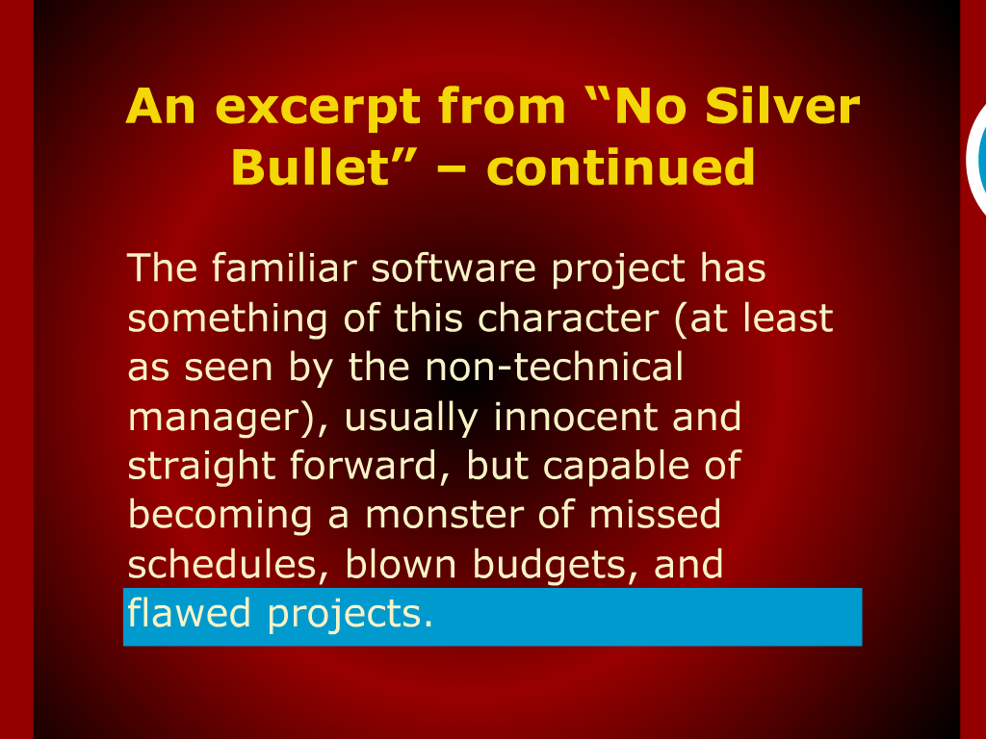

Slide 4
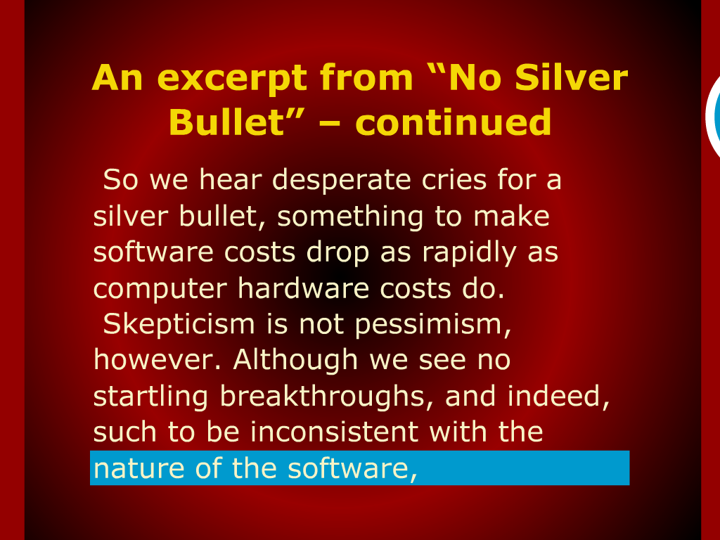

Slide 5
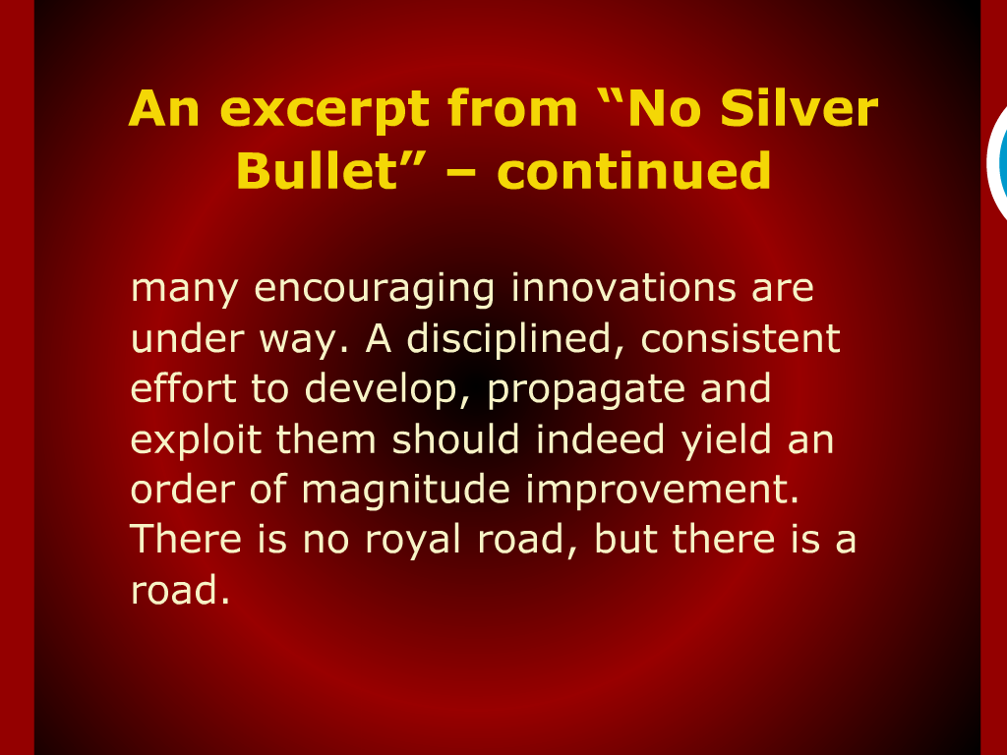

Slide 6
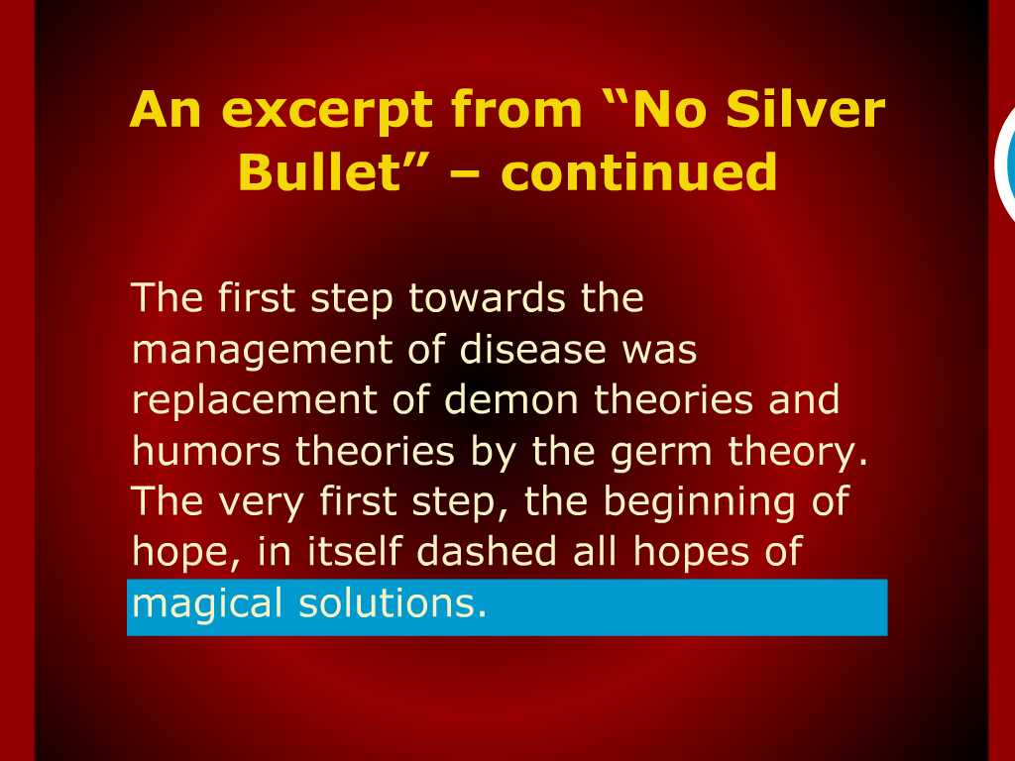

Slide 7
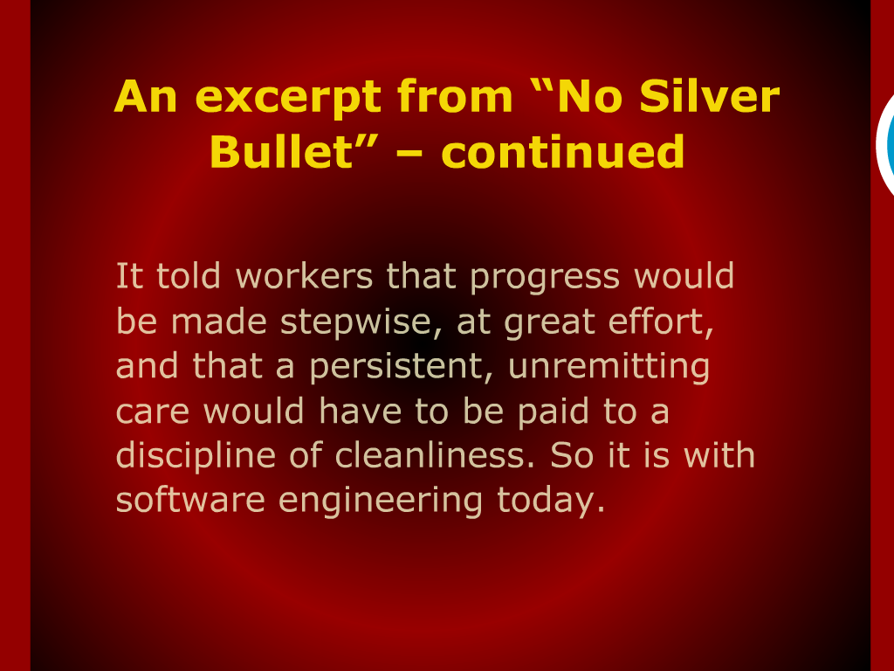

Slide 8
Software Engineering
The set of Processes, methods and tools to develop software.

Slide 9
Construction and Management

Slide 10
Software Development Phases

Slide 11
Importance Maintenance

Slide 12
Requirement Engineering

Slide 13
Functional and Non-functional Requirements

Slide 14
Use Case Model

Slide 15
Prototyping

Slide 16
Logical System Models

Slide 17
Coupling and Cohesion

Slide 18
Function Oriented versus
Object Oriented Design

Slide 19
Object Oriented Analysis and Design

Slide 20
Relationships among Objects

Slide 21
Dynamic Models

Slide 22
Software Architecture

Slide 23
Design Patterns

Slide 24
Writing Maintenance Code

Slide 25
Coding Style

Slide 26
Software Validation and Verification

Slide 27
Debugging

Slide 28
Software Design

